Slide 1
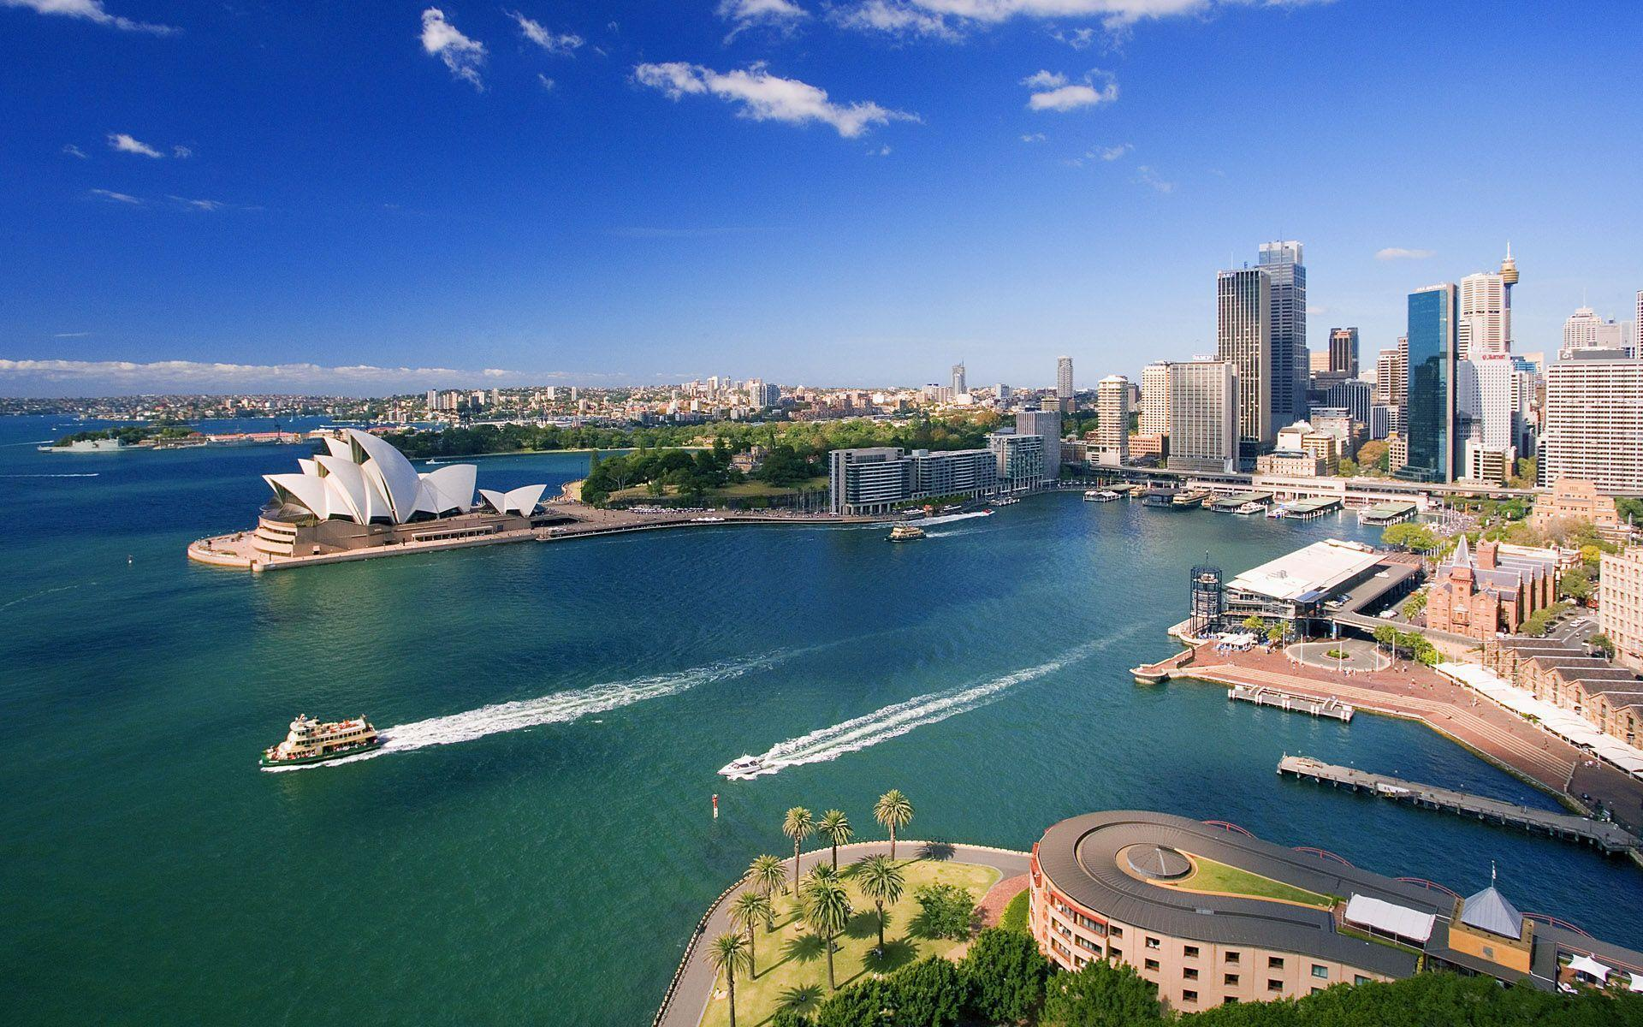
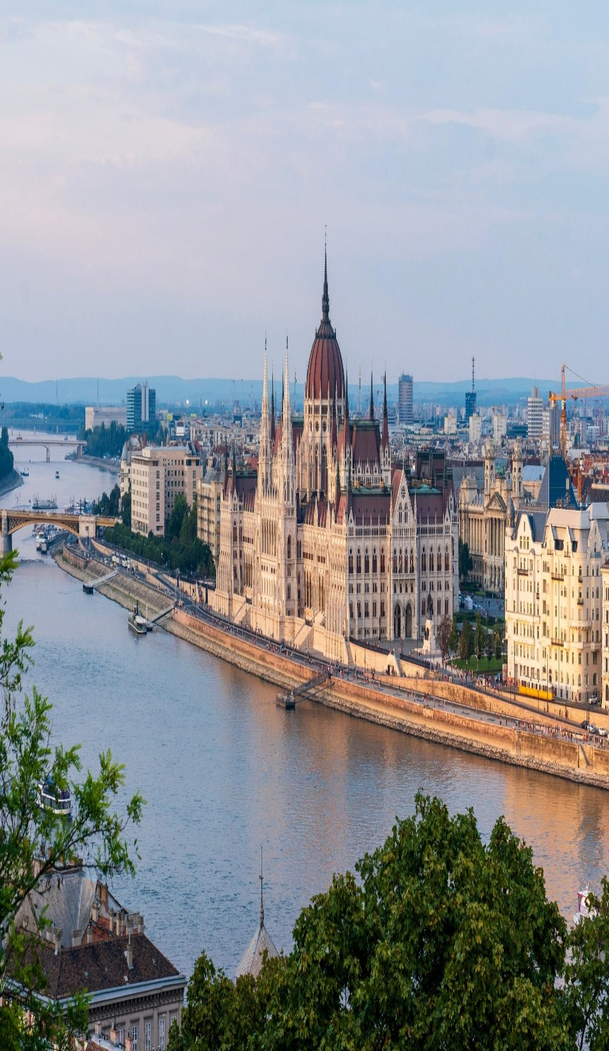

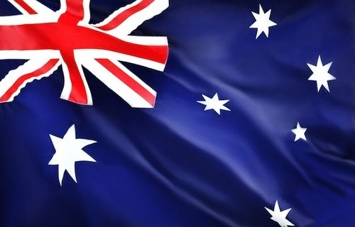


Dissecting a Country Under the Lens of Global Development
Australia
Hungary
Nepal
Groupmates:
Jaspher Jules Sales
Jasog Clarife
Kelzter Dwight Ongcol
Arvin Glen Hinoyog

Slide 2






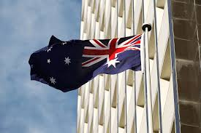
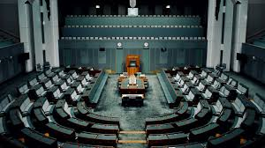
Australia

Slide 3
Data Centers and Cloud Infrastructure
Smart City Initiatives

Slide 4

National Broadband Network (NBN)
5G and Mobile Network Connectivity
Public Wi-Fi and Free Internet Access

Slide 5

Australia has one of the most highly regarded health care systems globally. It operates a universal public health care system known as Medicare.

Slide 6
General Practitioner
Specialist Care
Hospital Services
Mental Health Services etc.

Slide 7
Australia has a high enrollment rate across all levels of education, reflecting widespread access to learning opportunities.

Slide 8
Australian Curriculum
Teacher Quality
Equity and Inclusivity

Slide 9
Federal System
Australia follows a federal structure, meaning powers are divided between the Commonwealth (federal government) and the states and territories.

Slide 10
Australia has consistently ranked as one of the least corrupt countries in the world. In 2023, it scored 75 out of 100 on the CPI placing it among the top 15 least corrupt nations globally

Slide 11








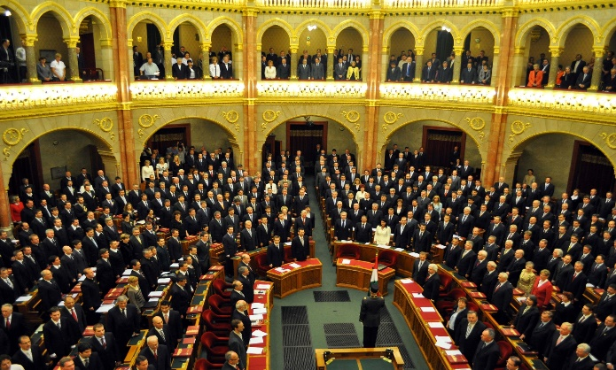
Australia
Hungary

Slide 12




Australia
Investment and development
Digital divides

Slide 13

Australia
Broadband access
4G and 5G rollout

Slide 14

Australia
The system is largely financed through the National Health Insurance Fund (NEAK)

Slide 15



Australia
Primary and specialist care
Hospital care
Emergency care etc.

Slide 16

Australia
Hungary has achieved relatively high enrollment rates across various levels of education, reflecting the country's commitment to universal access to education

Slide 17
Australia
Hungary’s education system offers a decent standard of education, but it faces some challenges.
Teacher quality and training
Infrastructure and resources

Slide 18

Australia
Prime Minister

Slide 19

Australia
Hungary scored 42 out of 100, ranking 77th out of 180 countries globally (2022 data).

Slide 20




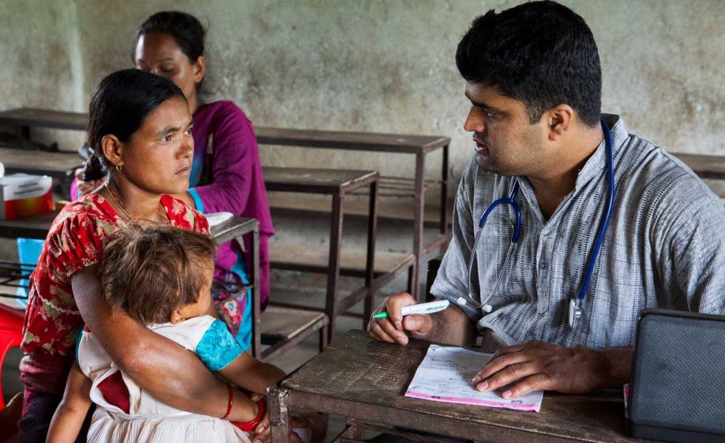
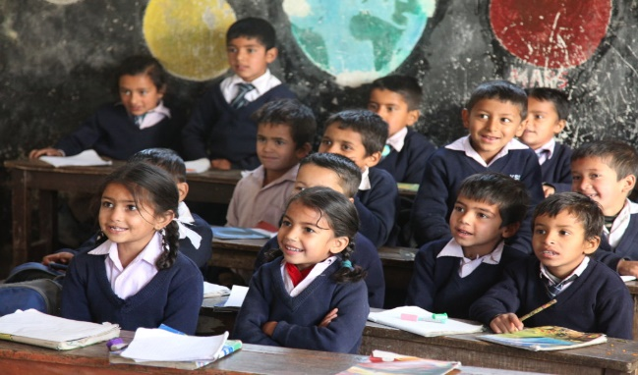
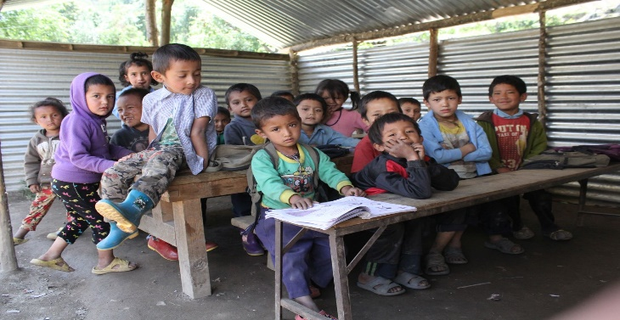
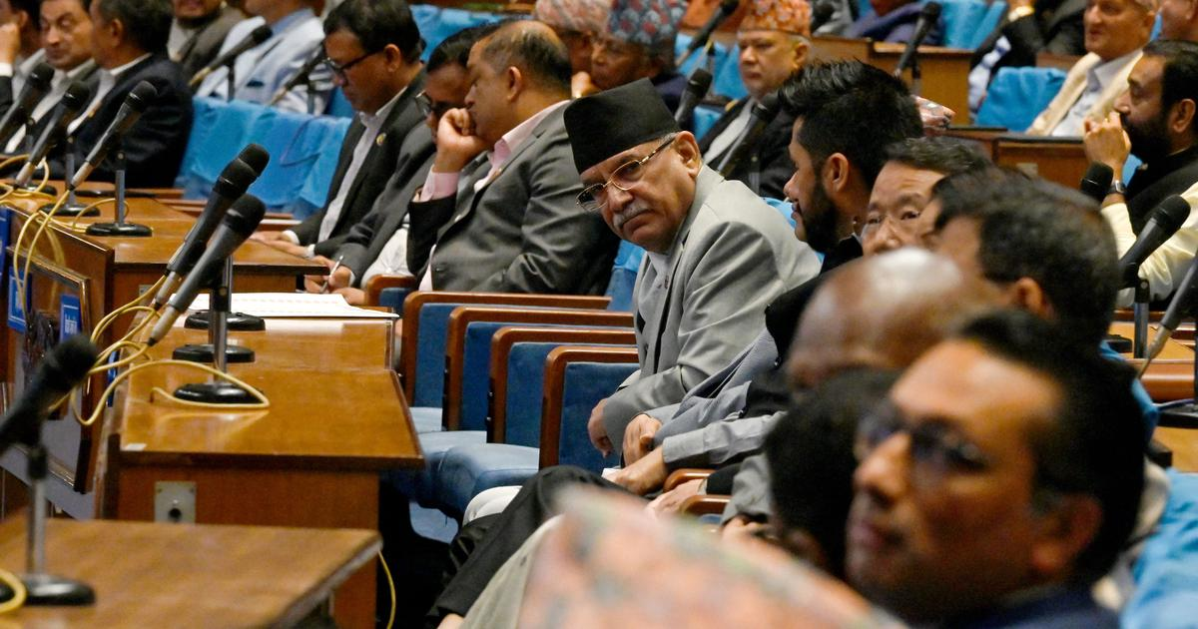
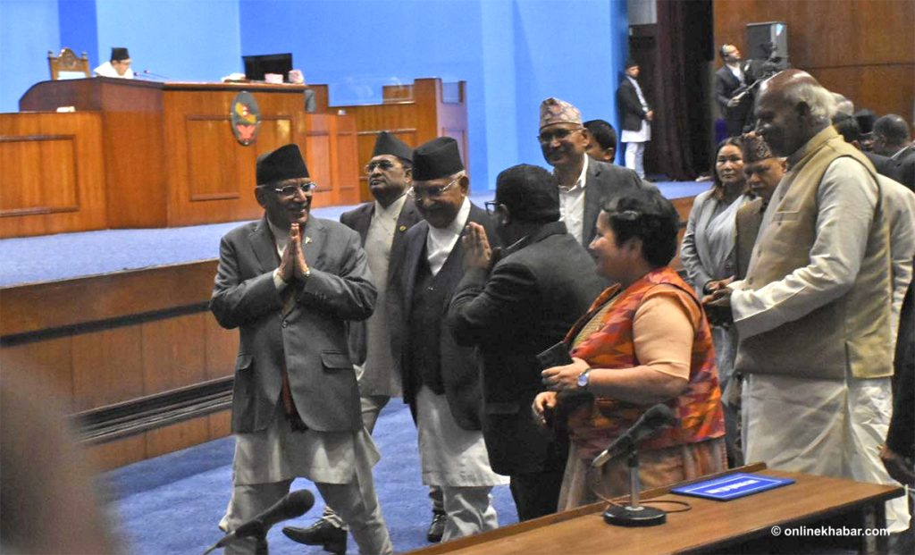
Nepal

Slide 21


Data Centers
E-Governance
Digital Payment Systems

Slide 22
Internet Penetration
Mobile Connectivity
Telecommunication Providers
Affordability

Slide 23

Nepal's healthcare system has made significant strides in recent years, but it still faces several challenges, especially in terms of accessibility, quality, and coverage.

Slide 24
Free Basic Health Services
Essential Medicines
Maternal and Child Health

Slide 25

While many children have access to schools, issues related to infrastructure, teacher quality, and curriculum development affect the overall quality of education.

Slide 26

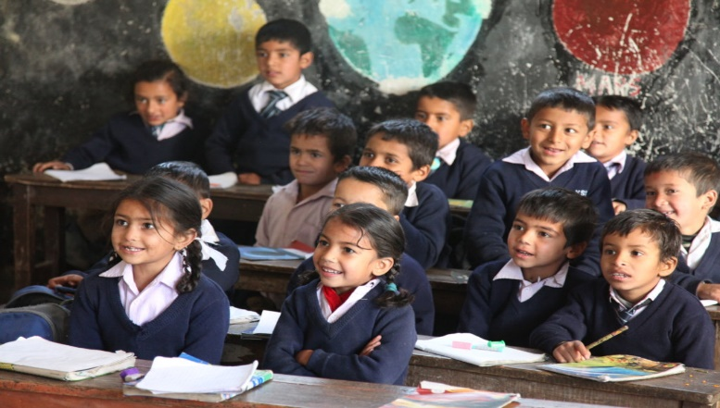
Teacher Quality
Curriculum and Teaching Methods
Learning Outcomes
School Infrastructure

Slide 27

Federal Democratic Republic: Nepal is a federal democratic republic, established after the promulgation of the Constitution of Nepal in 2015.

Slide 28
In the 2023 CPI, Nepal scored 42 out of 100, ranking 116th out of 180 countries. This score indicates that corruption remains a significant issue in the country

